Slide 1
Mechanical Design
Wearable Device

Slide 2
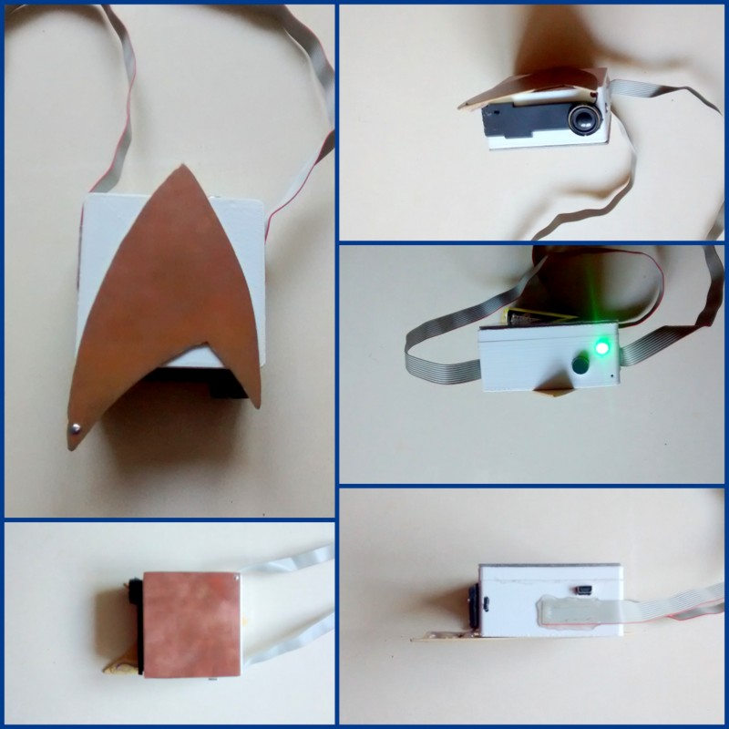
FRONT VIEW
BOTTOM VIEW
TOP VIEW
(with LED)
BACK VIEW
SIDE VIEW

